Slide 1





Slide 2


Equipe
Enan Henrique
02211011
João Victor Ruas
02211038
Henrique Piassi
02211028
Lucas Teixeira
02211043
Roberta Pires
02211057

Slide 3
Visão do Projeto

Slide 4

Mercado IOT

Slide 5
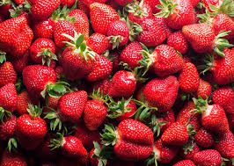
Contexto
01
02
03
About Us
Market Analysis
Goals and Strategy
04
05
06
Content Plan
Budget
KPI Overview
Foco de mercado
Here you could describe
the topic of the section
Here you could describe
the topic of the section
Here you could describe
the topic of the section
Here you could describe
the topic of the section
Here you could describe
the topic of the section
Here you could describe
the topic of the section

Slide 6
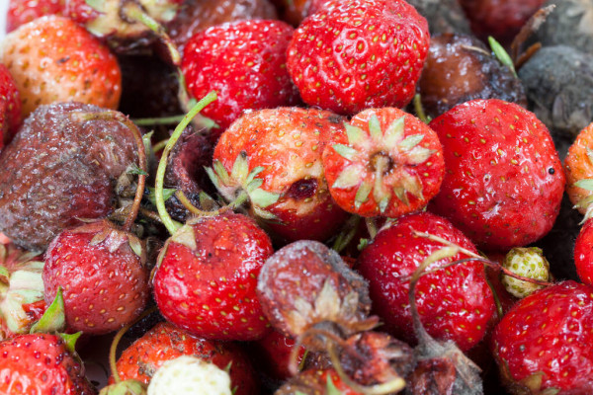


Problemática
Variação de temperatura
Variação de umidade
Morte da plantação

Slide 7
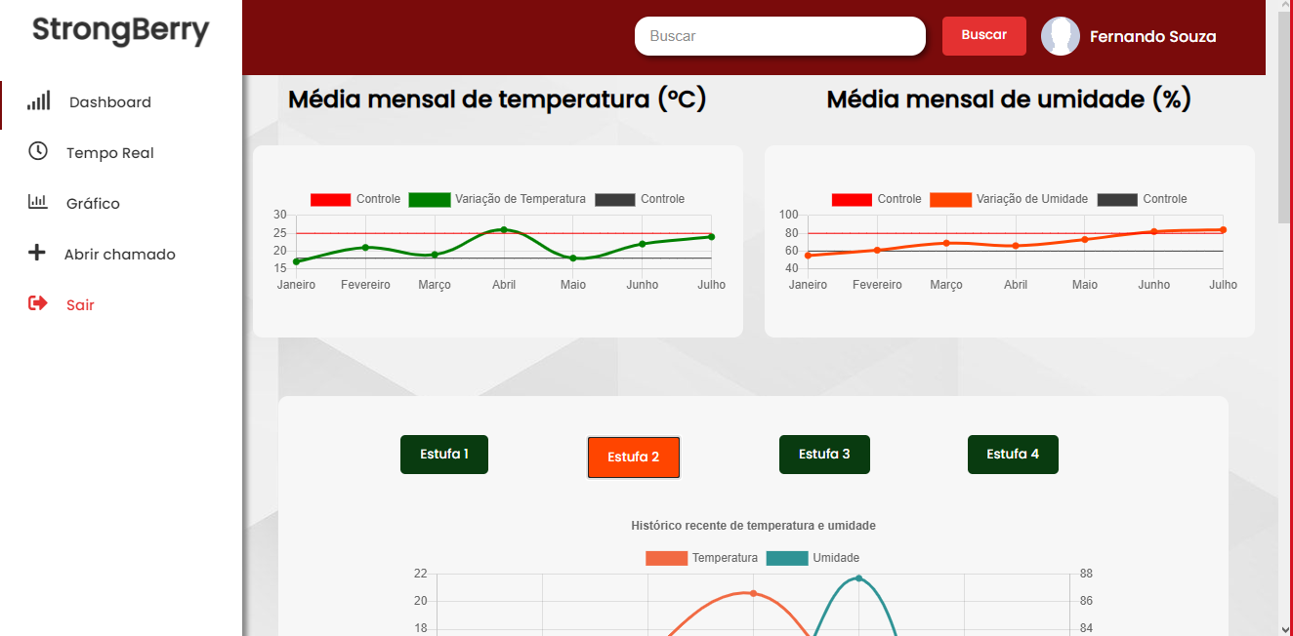

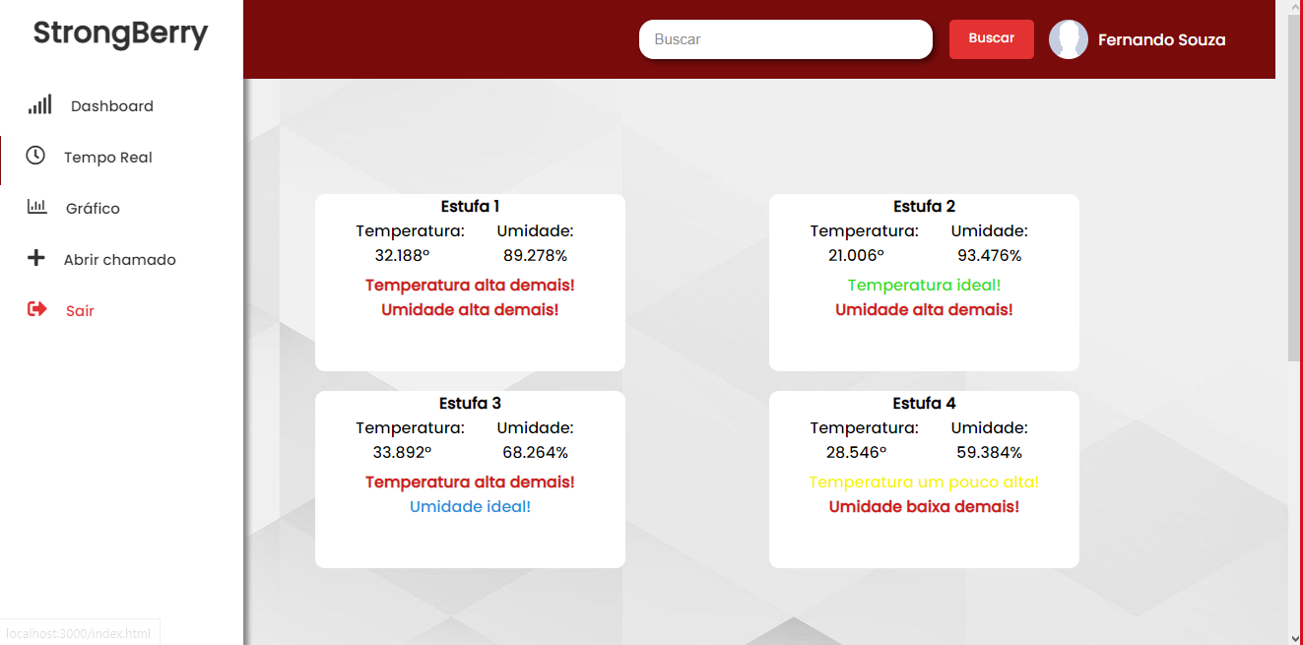




Nossa solução
Mars
Jupiter
Saturn
Monitoramento de estufa com sensor de temperatura e umidade
Despite being red, Mars is a cold place. The planet is full of iron oxide dust
Jupiter is a gas giant and the biggest planet in our Solar System
Saturn is the ringed one. It’s a gas giant, composed mostly of hydrogen and helium

Slide 8
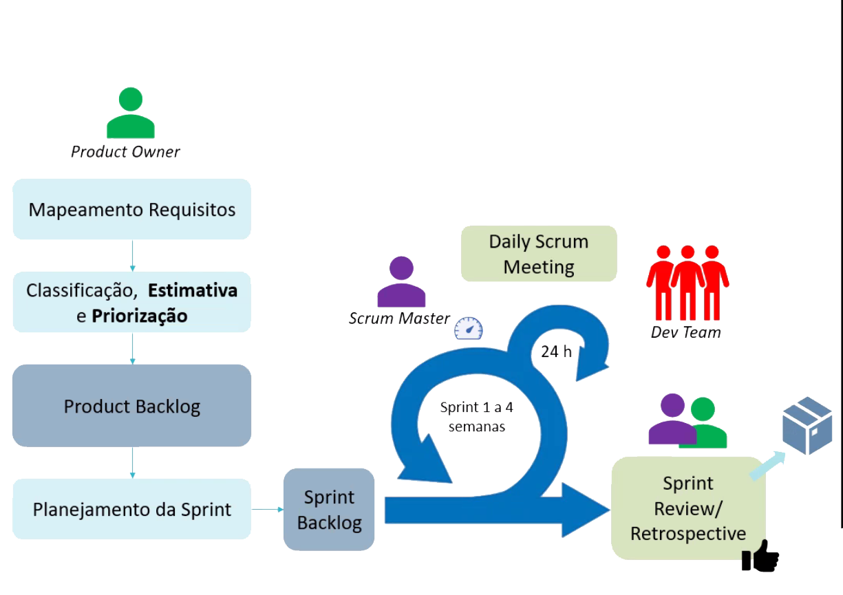
Planejamento

Slide 9
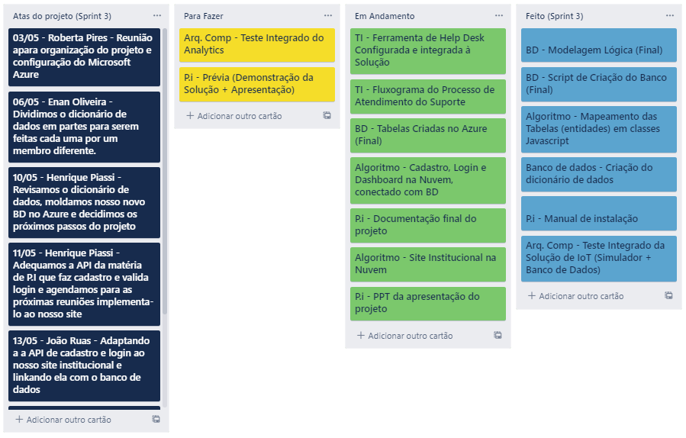

Metodologia

Slide 10
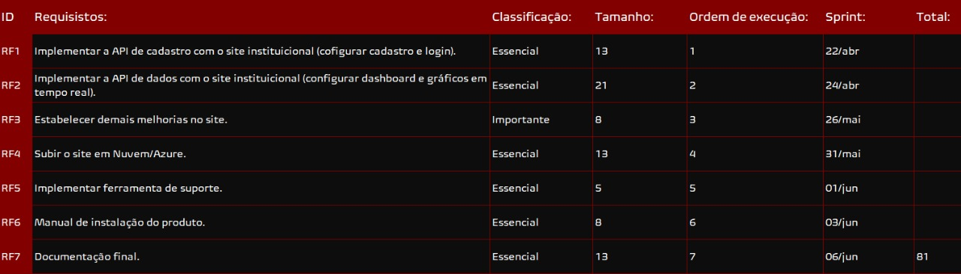
Backlog e Sprints

Slide 11
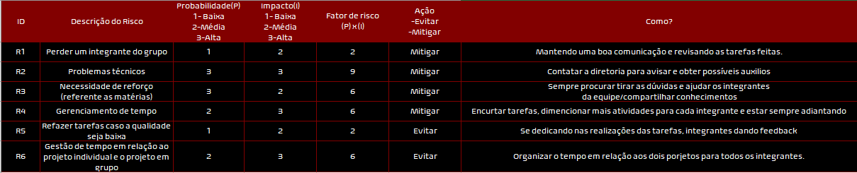
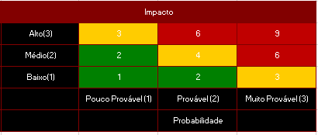
Mapeamento de Riscos
Mars
Jupiter
Saturn
Despite being red, Mars is a cold place. The planet is full of iron oxide dust
Jupiter is a gas giant and the biggest planet in our Solar System
Saturn is the ringed one. It’s a gas giant, composed mostly of hydrogen and helium

Slide 12
Desenvolvimento do Projeto

Slide 13
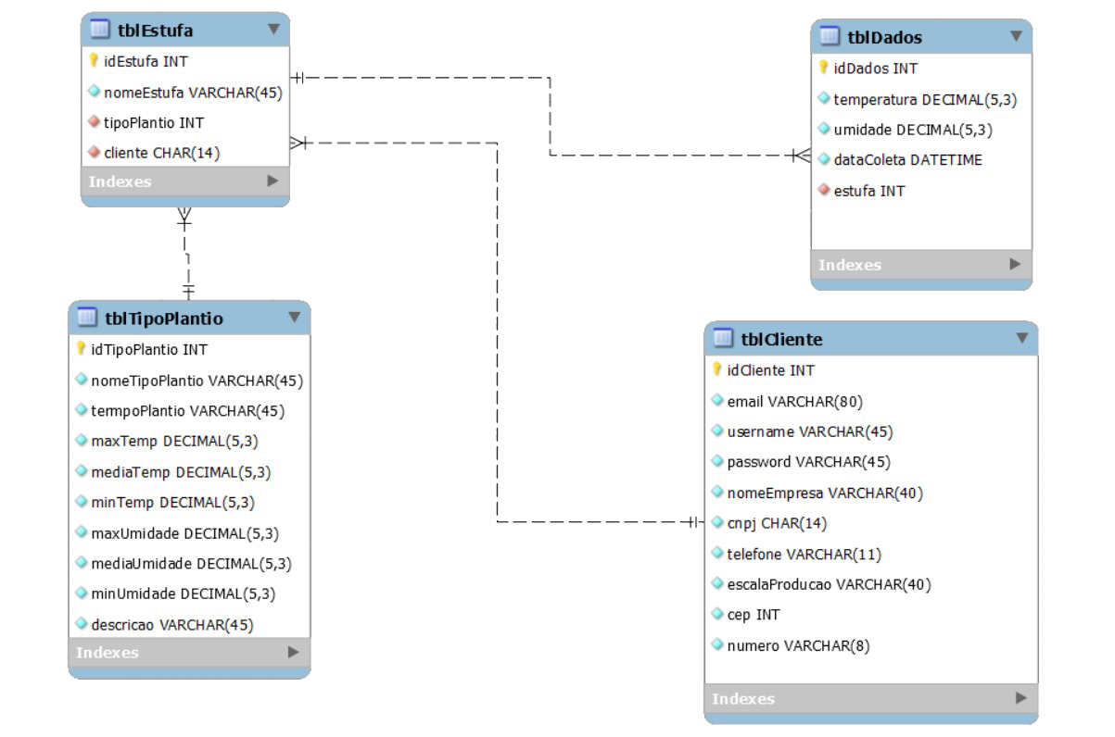
Modelo de dados

Slide 14
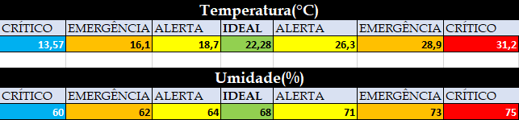
Parâmetros e Analytics

Slide 15

Demonstração

Slide 16
Suporte e Ferramenta

Slide 17
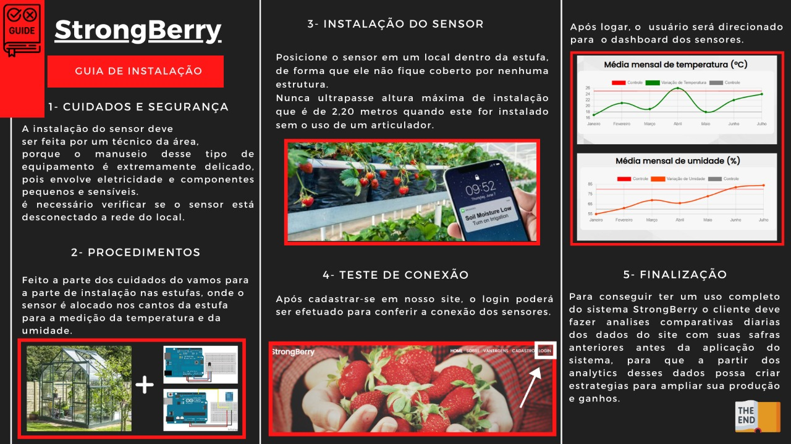
Manual de Instalação

Slide 18
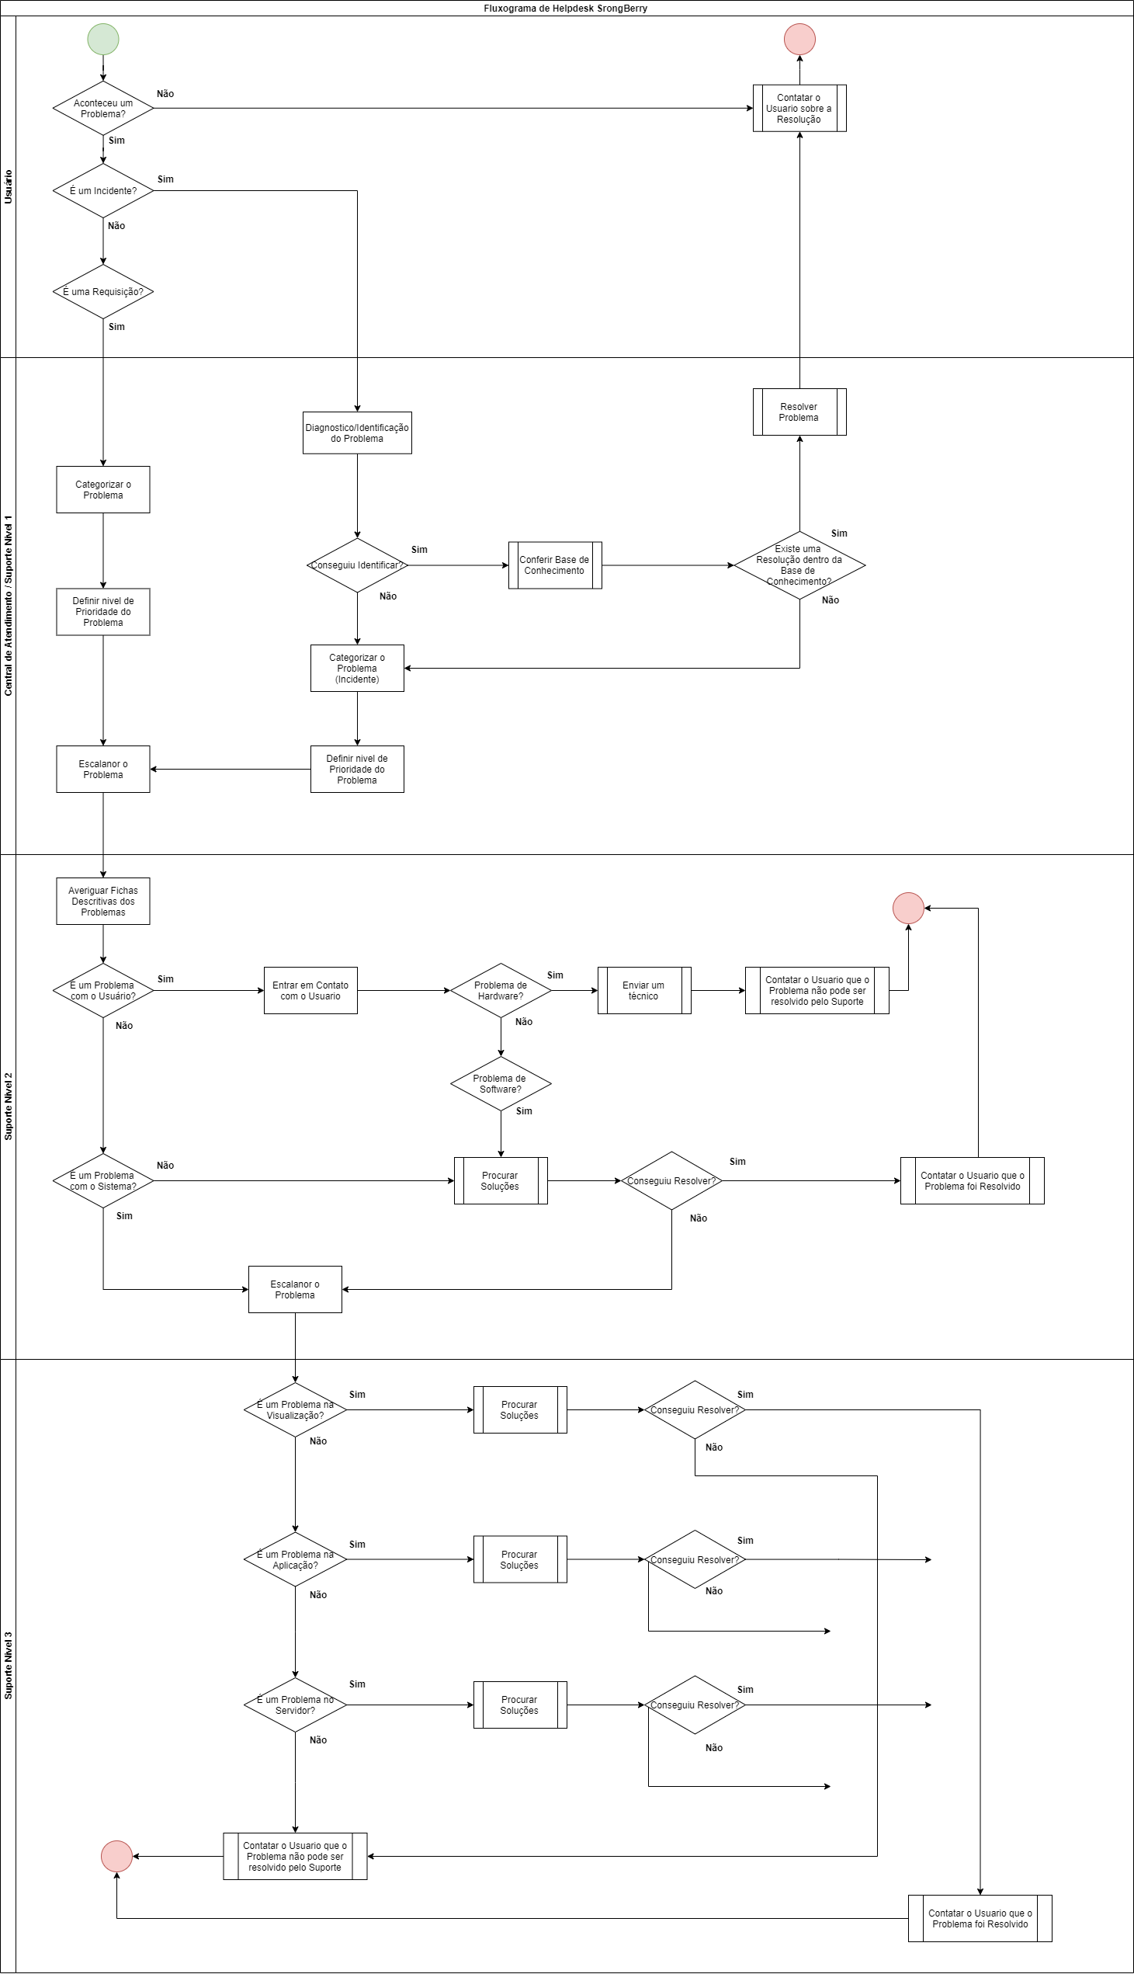
Processo de atendimento

Slide 20
Conclusão

Slide 21


Obrigado!!!

